Slide 1

HR Analytics Employee Attrition

Slide 2

Presentation Outline
Dataset Explanation
Conclusion
Objectives of the project
Data Analysis
Training the Model
Evaluating the Model
Research Problem
Detecting Attrition

Slide 3

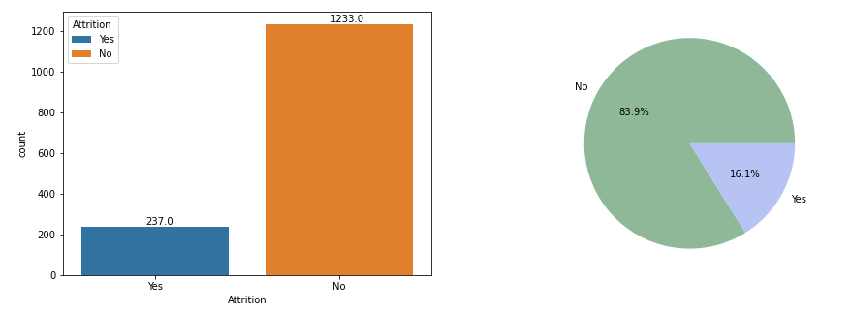
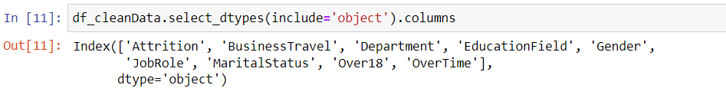
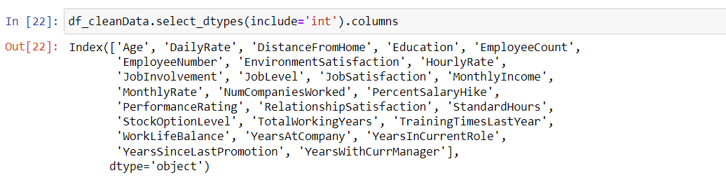
Dataset Explanation
The data set used in this project is employee attrition data set. This data set data set has been downloaded from Kaggle.com. It contains 35 variables and 1470 records.
The link to the data set is https://www.kaggle.com/datasets/pavansubhasht/ibm-hr-analytics-attrition-dataset

Slide 4

Problem Statement
According to Society for Human Resource Management (SHRM), the average cost per hire for a new employee is 4129 USD. According to the stats, in the year 2021, 57.3% is the attrition rate of employees. The employee attrition results in a massive loss for an organization. There is a need to implement a study to find the causes of employee attrition and a learning framework to predict employee attrition.
This Photo by Unknown Author is licensed under CC BY-SA-NC

Slide 5
Objectives of the project
This project aims to analyse the factors that effects the employee attrition through exploratory data analysis.
To predict employee attrition by training the two supervised machine learning models. The two supervised machine learning models were logistic regression and decision trees.
To evaluate the two supervised machine learning models.
To detect the employee attrition rate using the two trained models

Slide 6
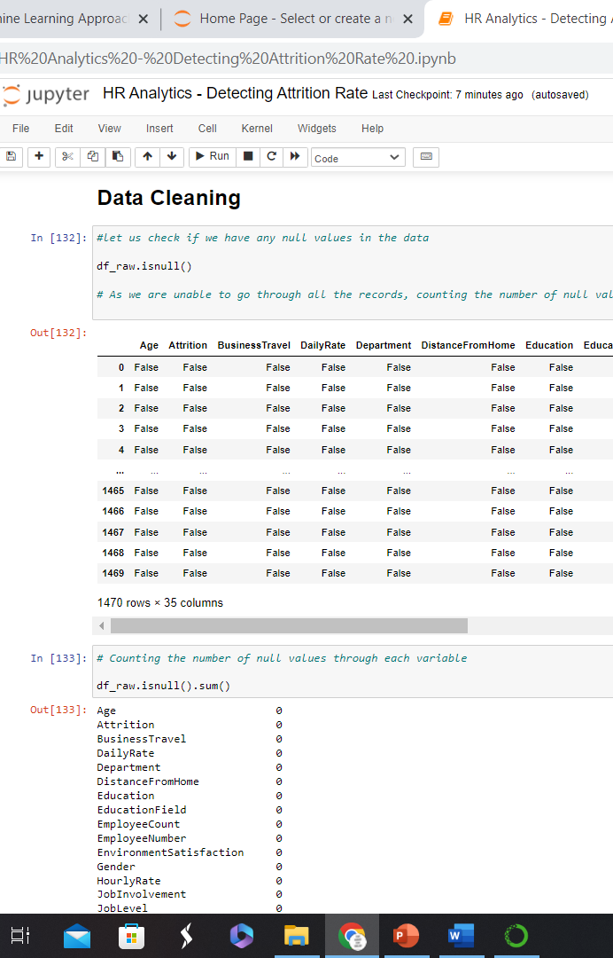
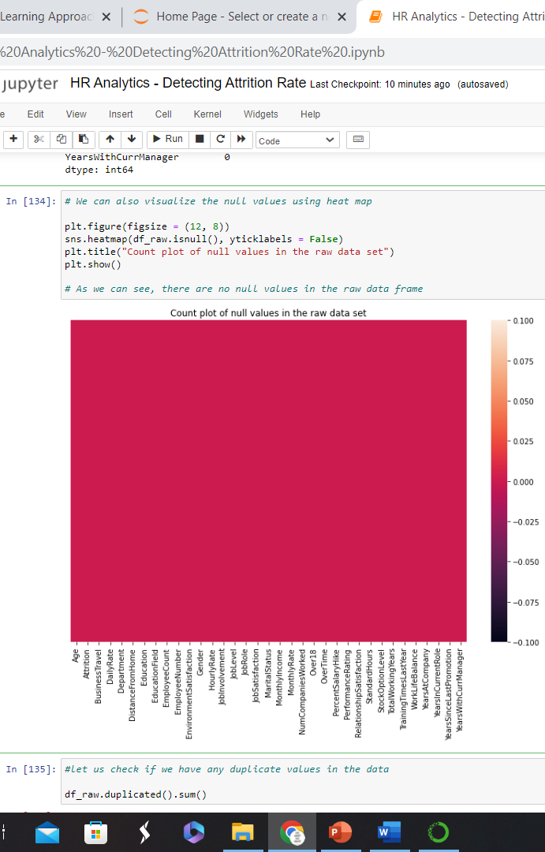
Data Cleaning, Exploratory Data Analysis, and Feature Selection
Identifying the null attributes in the data
Removing irrelevant attributes in the data set
Ex: Employee count, employee number (which doesn’t make any sense)
With the help of heat maps create using correlation, we identified the features that are highly correlated.
Created dummy variables for categorical data for training the model.

Slide 7
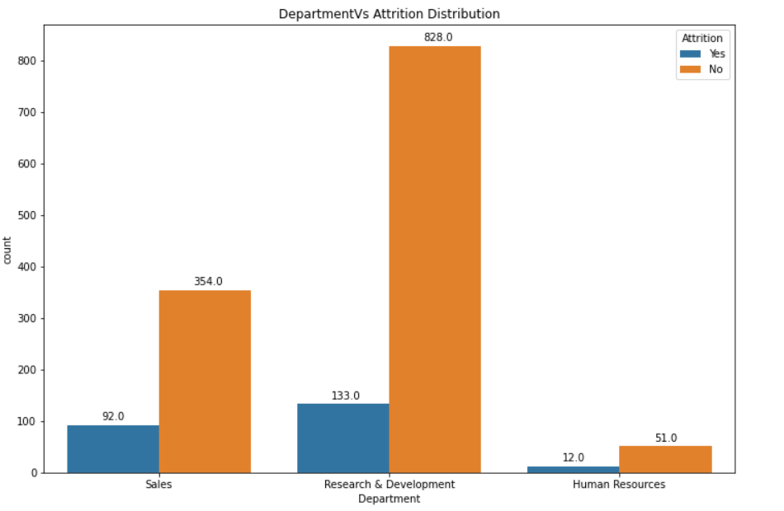
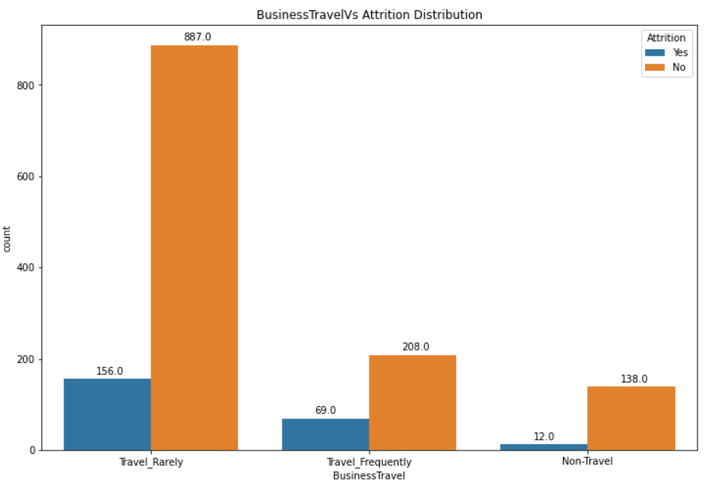
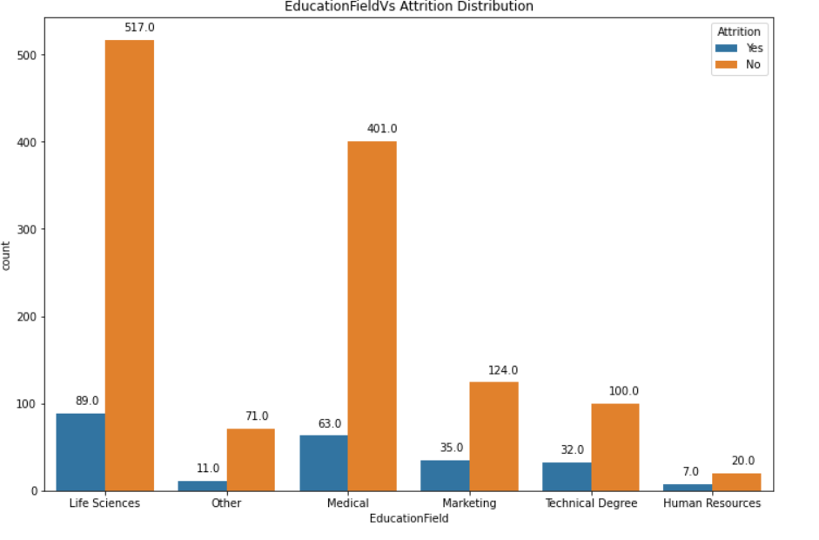
Categorical Data Analysis
Department VS Attrition | In all three departments, sales dept has more attrition when compared to other
Business travel VS Attrition | Frequently travelling people has seen more attrition and non – travel people has less attrition
Education VS Attrition | HR degree has more attrition followed by technical degree

Slide 8
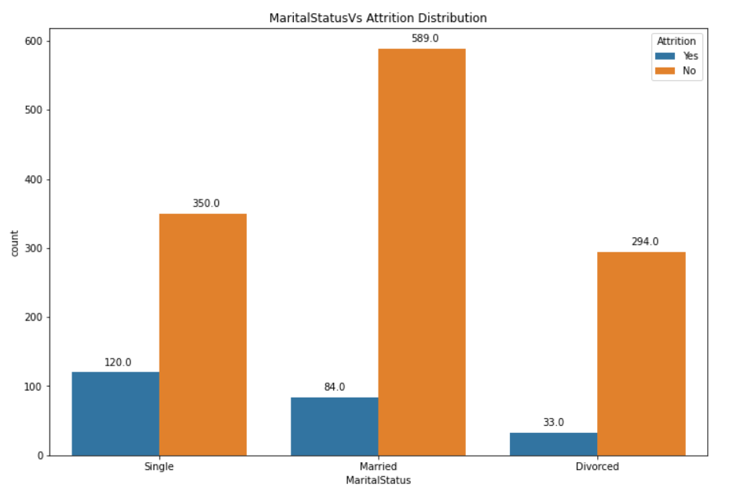
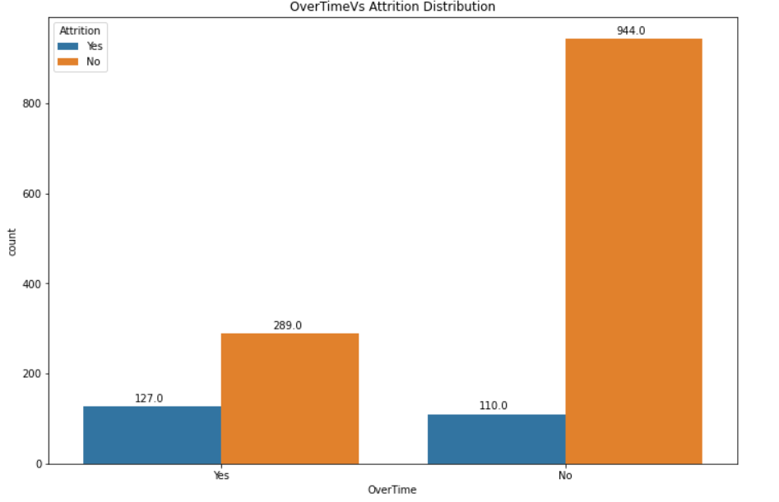
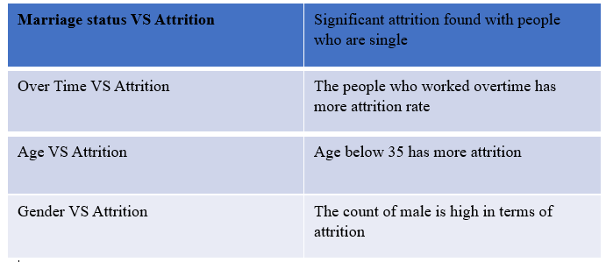
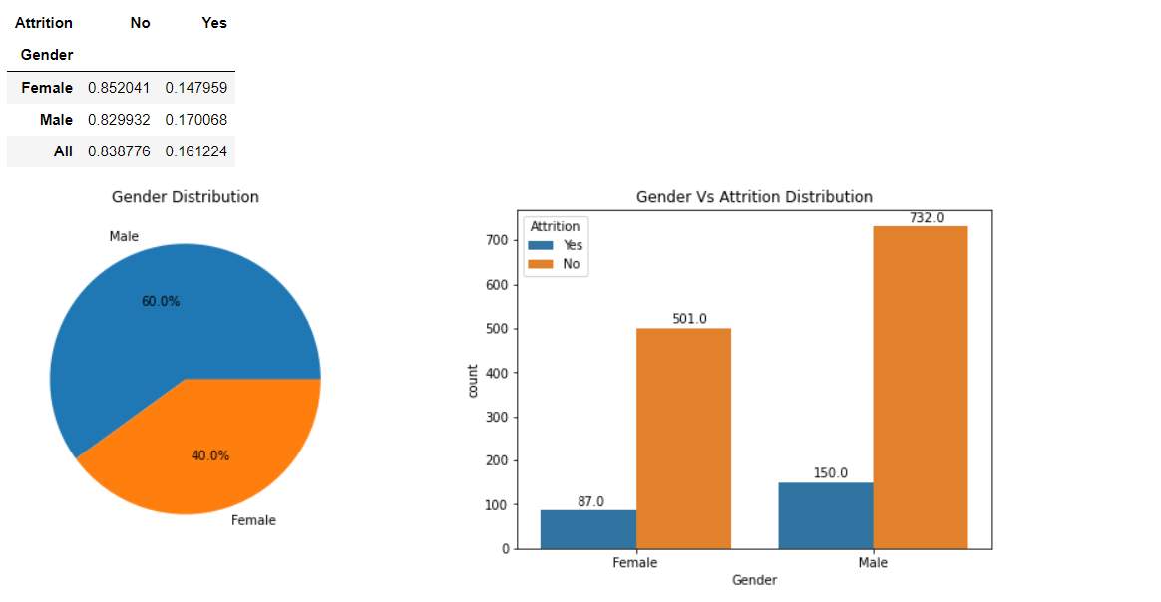
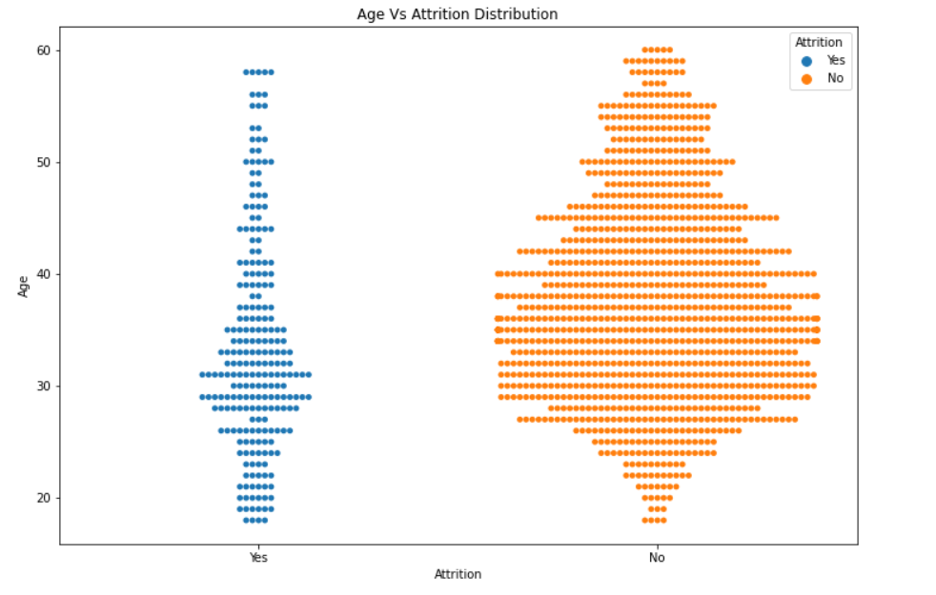
Categorical Data Analysis

Slide 9
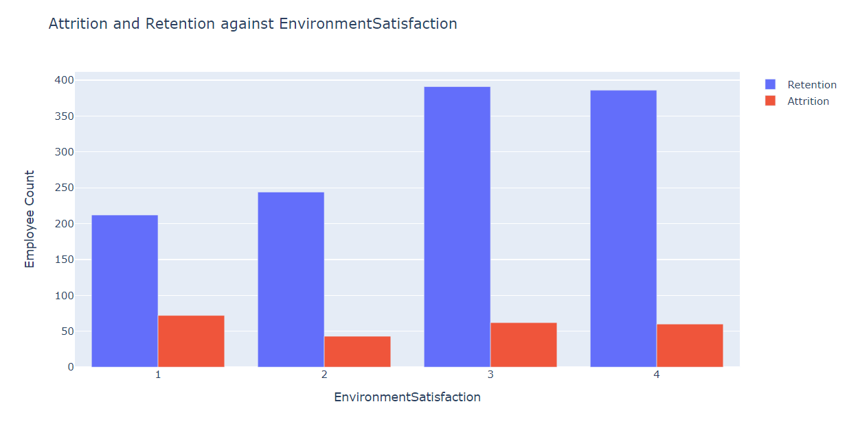
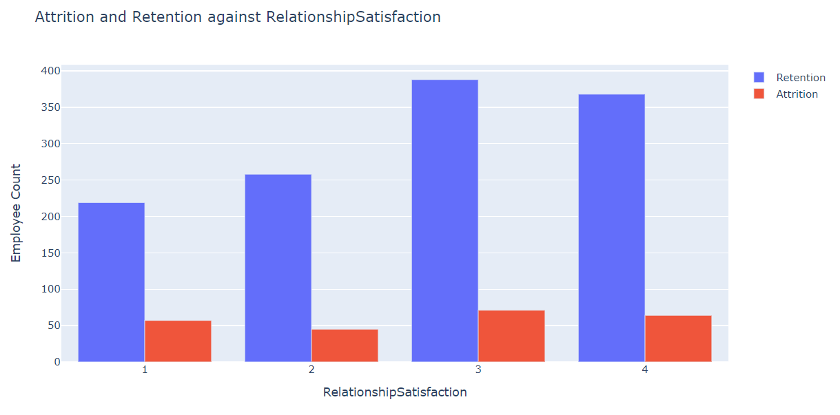
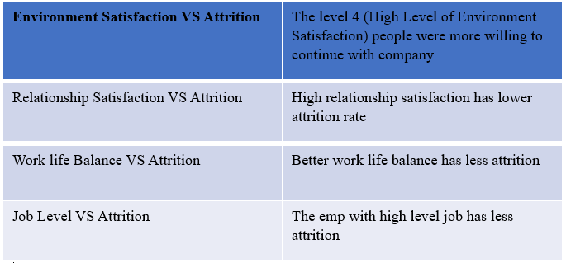
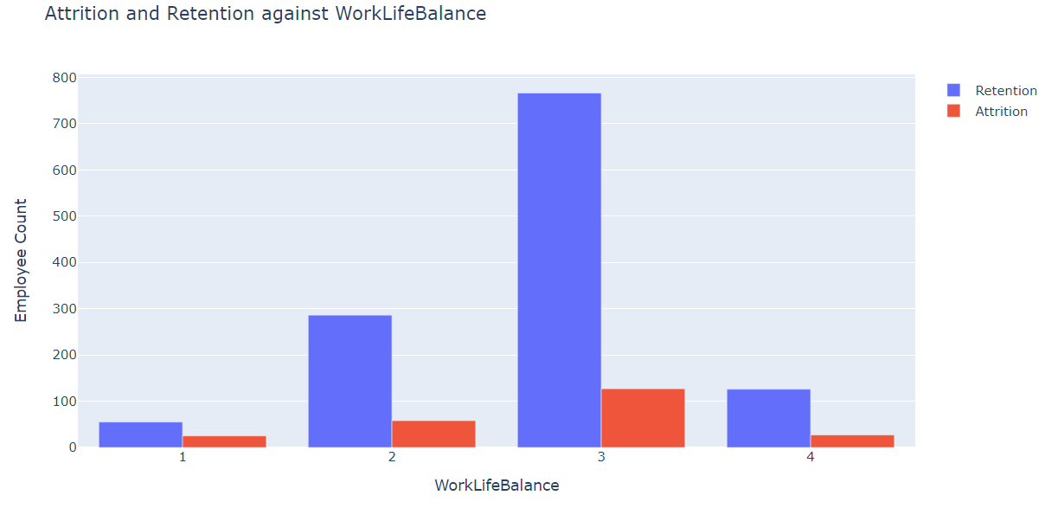
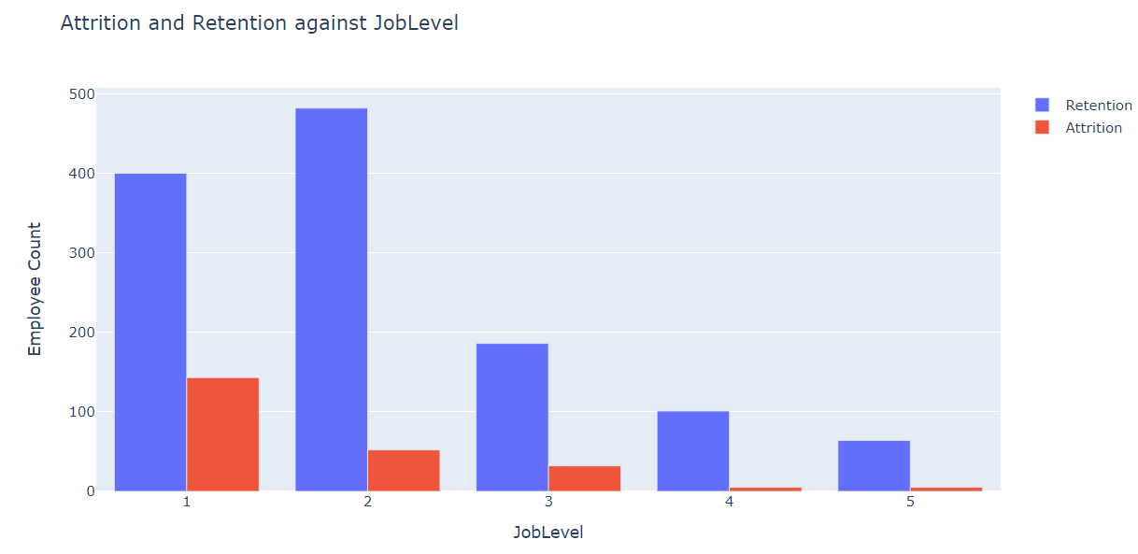
Numerical Data Analysis

Slide 10
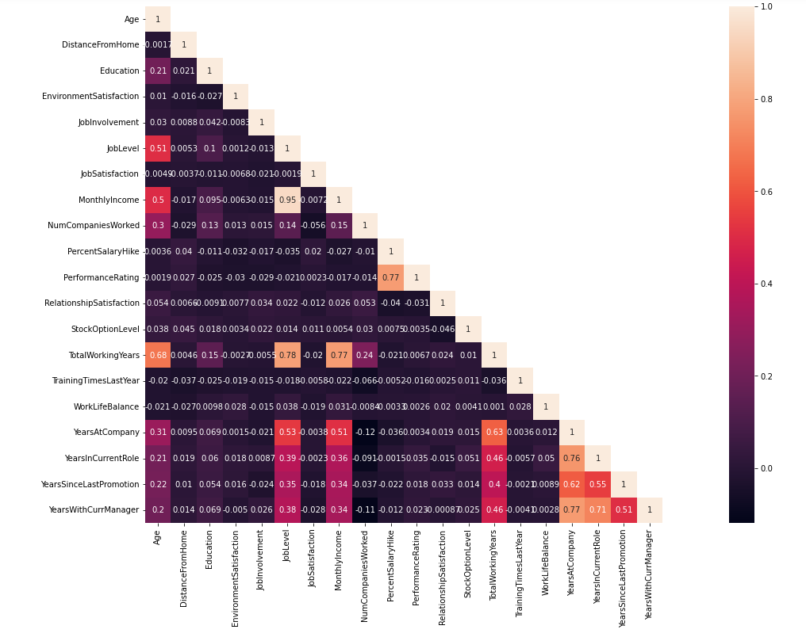

Feature Selection

Slide 11
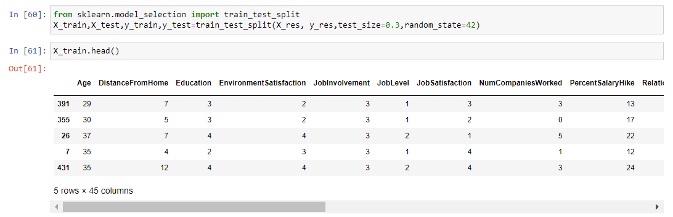
Under sampling – Train Test Split
As we saw that our data is imbalanced which leads to imbalanced classification problem. To overcome this, we did under sampling using near miss algorithm

Slide 12
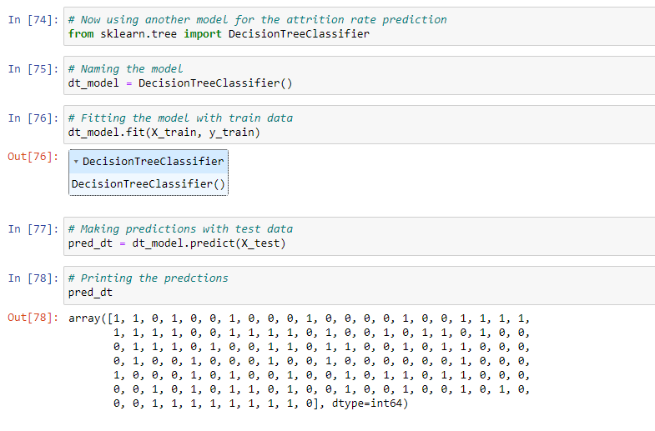
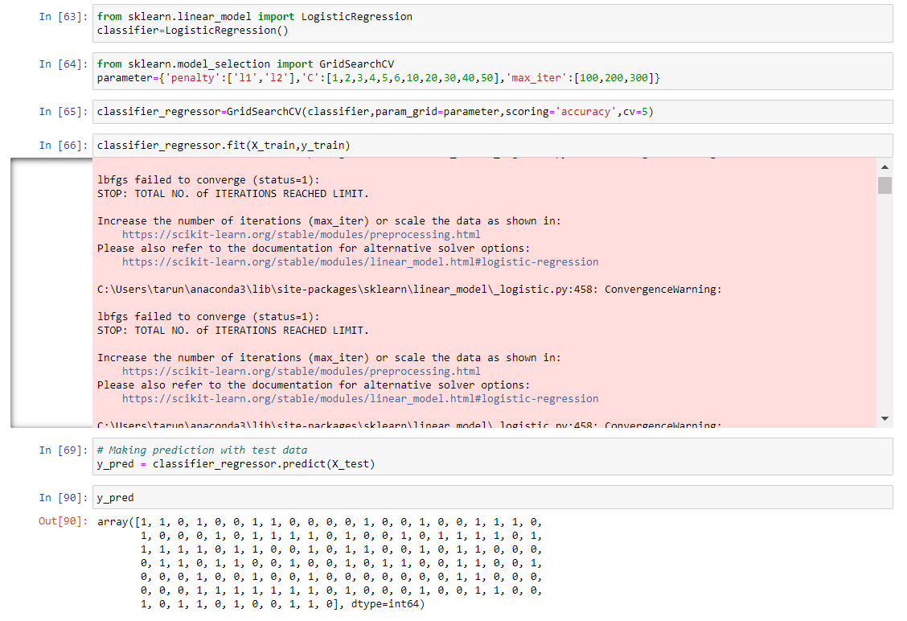
Model Training
We have trained our data using logistic regression and decision tree models.
Both the models were fitted with train data
We made predictions using the test data

Slide 13
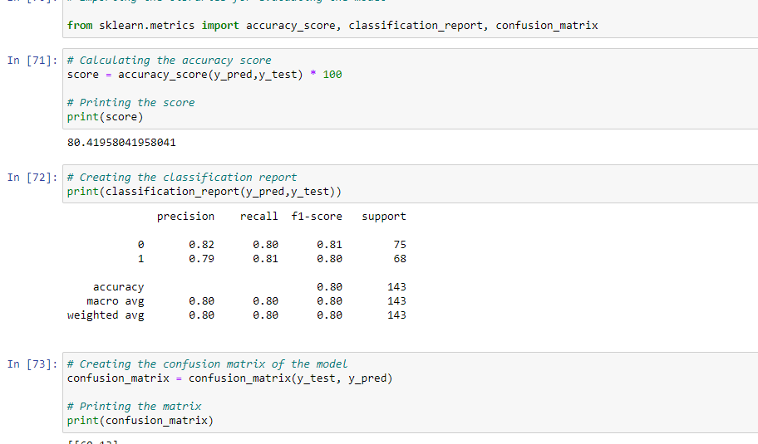
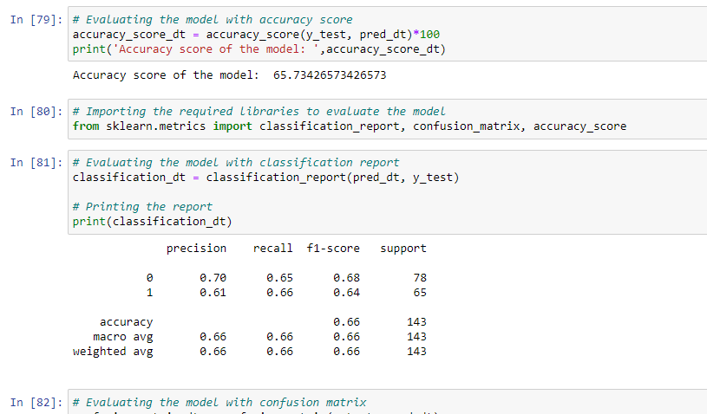
Model Evaluation
We have evaluated both the models using the accuracy score, classification report, and confusion matrix
The logistic regression predicts the attrition with 80% accuracy
The decision tree model predicts the attrition with 70% accuracy

Slide 14
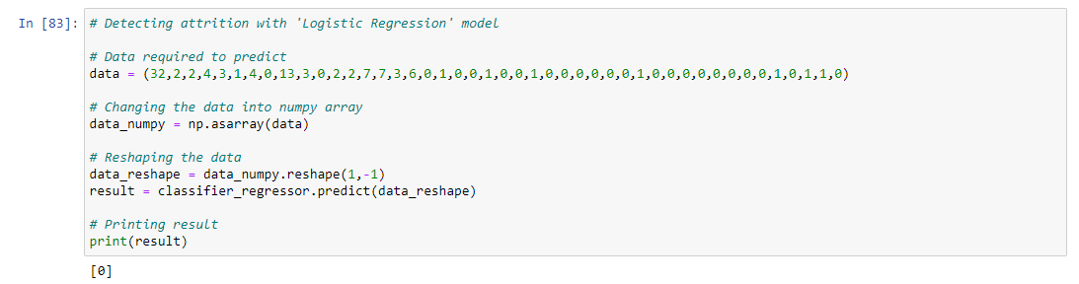
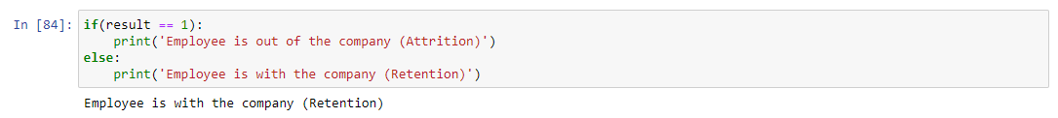
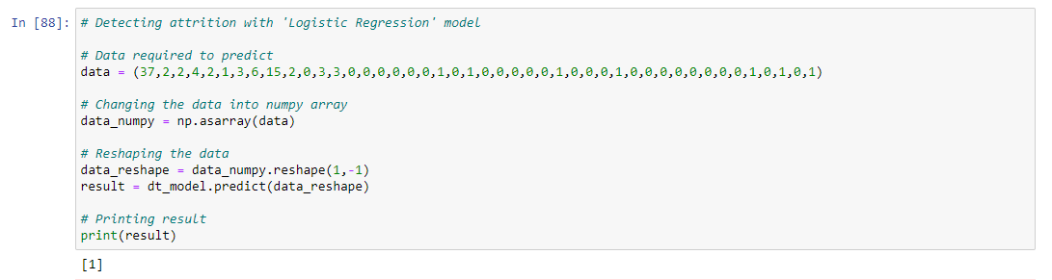
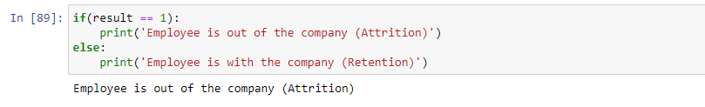
Detecting attrition with sample data
We have tested the trained model using the sample data
Both trained models predicts accurately with the given information

Slide 15

Conclusion
Based on the exploratory data analysis, we can say that every attribute has a level of attrition and retention. However, attributes like Over Time, Years at company, Distance from home, education field, years in current role, years with current manager are affecting the attrition.
On testing the sample data with the models trained, models predicted the right attrition.

Slide 16

References
Kamath, R. S., Jamsandekar, S., & Naik, P. (2019). Machine Learning Approach for Employee Attrition Analysis . Machine Learning Approach for Employee Attrition Analysis , 62-67.
Raza, A. (2022). Predicting Employee Attrition Using Machine Learning Approaches. Applied Sciences, 1-17.

Slide 17

Thank You

